Slide 1
Corner Clipping events in icecube
Michael Bogert
Advisor: Dr. Kurahashi

Slide 2
Brief overview
Background info
IceCube, neutrino events
Purpose of my research
The problem, what I’m trying to accomplish, why it’s important
Steps I took
Results, discussion

Slide 3
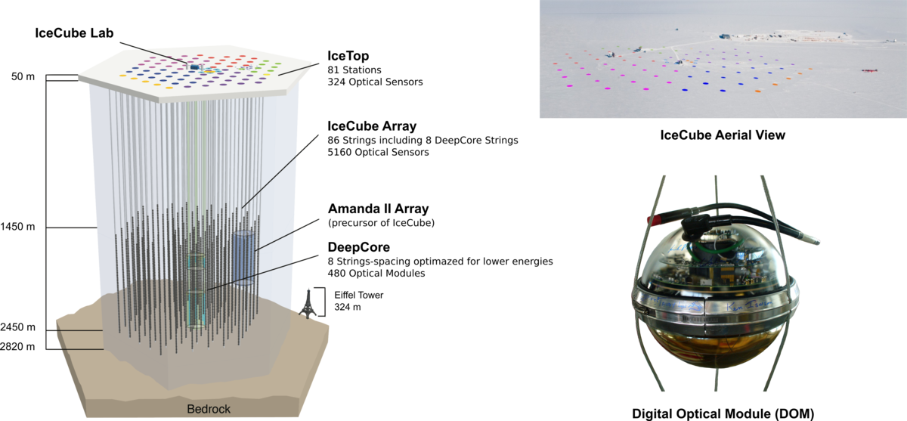
IceCube
Neutrino detection experiment
1 km³ detector with 5,000 light sensors (DOMs)
Picture from https://www.iihe.ac.be/icecube

Slide 4
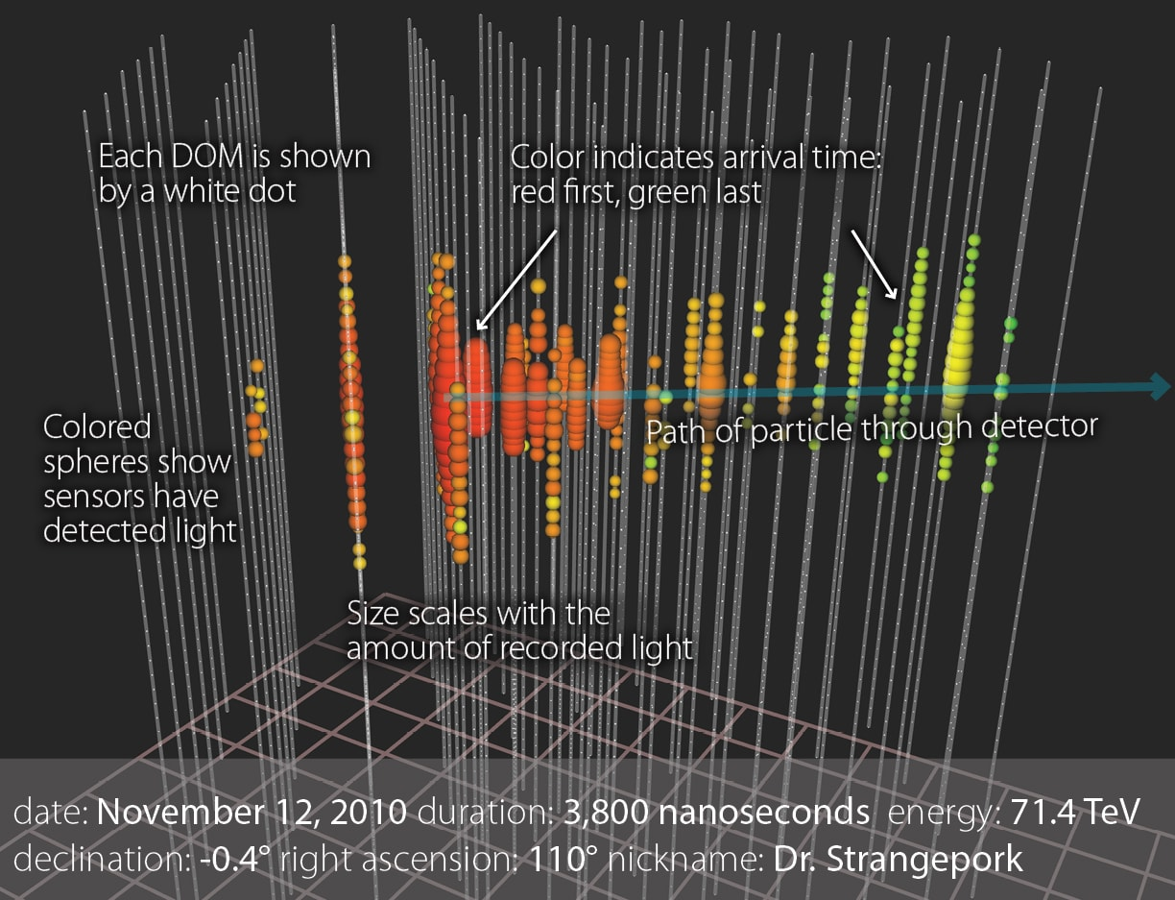
What is an event?
Neutrino interaction recorded by detector
Events are viewed in steamshovel, a visualization software
Picture from https://icecube.wisc.edu/science/icecube/

Slide 5
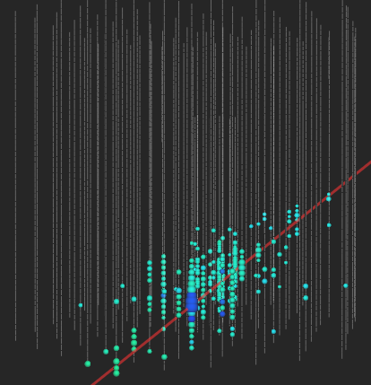
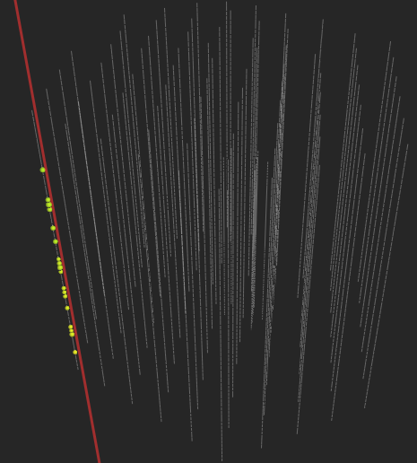
Event Categories
Two categories: Normal events and corner clipping events
Reconstruction of a corner clipper can’t be trusted
Normal event
Corner clipper

Slide 6
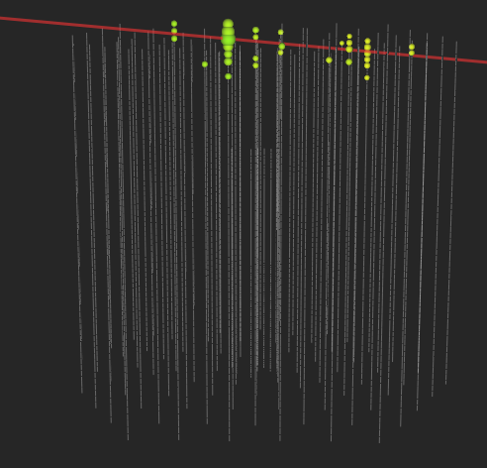
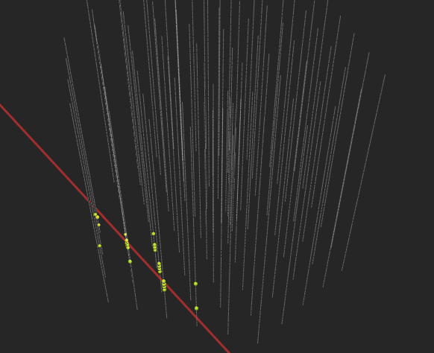
Multiple types of clippers
Corner clippers don’t just have to be on 1 or 2 strings
Can clip the top/bottom of detector
Can cut through a side
Clip through top of detector
Clip through multiple strings

Slide 7
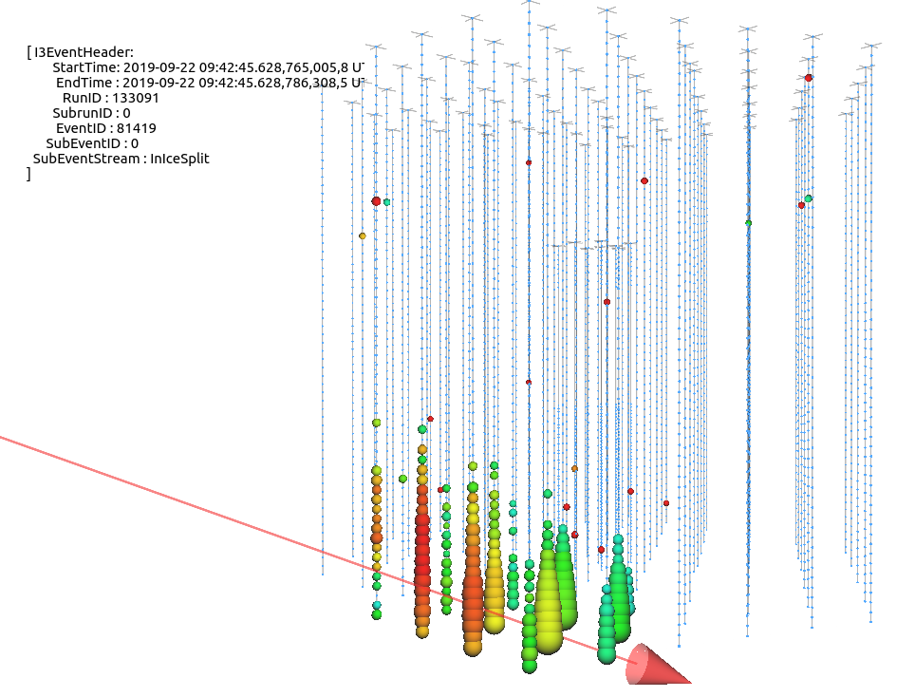
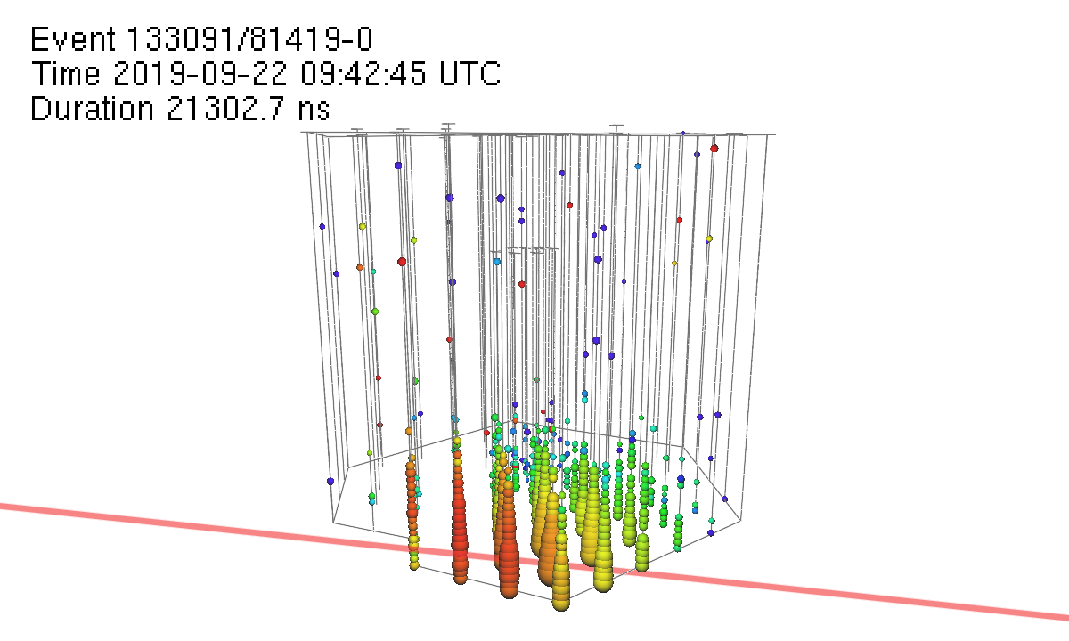
The problem
Detector constantly recording events (10¹¹ events per year)
No method to filter out corner clippers
Easily identifiable by eye, but difficult to define algorithmically
Alerts are sent out for interesting events ( > ~330 TeV)
Sent out automatically before visual confirmation, may be retracted

Slide 8
Goal/why it matters
Goals
Come up with a reliable way to classify events (normal or corner clipper)
Use machine learning to further improve classification
Why it matters
Significant number of corner clippers (too many to go through by eye)
Reconstructing corner clippers wastes time/resources

Slide 9
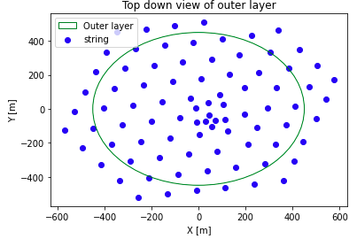
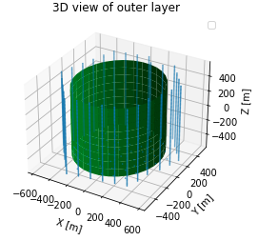
Initial steps
Get familiar with corner clippers
Come up with common features all corner clippers should share

Slide 10
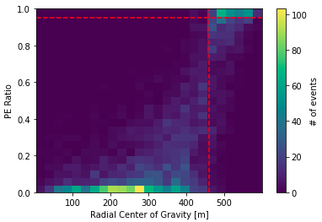

Common features
Decided all corner clipping events should have a “radial center of gravity” far from the center^{[1]}
$$COG\left(ρ\right)= \frac{\sum_{i=0}^{\#DOMs}{q_{i}}ρ_{i}}{\sum_{i=0}^{\#DOMs}{q_{i}}}$$
where $q_{i}$ = # of photoelectrons (PEs) at the i^{th}
DOM, $ρ_{i}$ is the radial distance
Should also have high ratio of $\frac{\# Outer PEs}{\# Total PEs}$

Slide 11

Starting point
Hypothesized cluster of events in top-right corner of 2D histogram were corner clippers – they were
Could now use $COG\left(ρ\right)$ and PE ratio as features in machine learning algorithms
Secondary features added
$COG\left(z\right)$ - vertical center of gravity
Total PEs – Corner clippers should have low # of total PEs

Slide 12
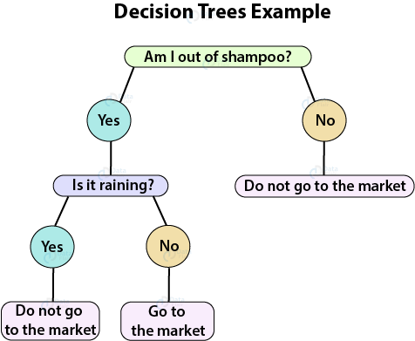
Machine learning algorithms
Machine learning algorithms are methods that will predict results based on input data^{[2]}
4 categories: unsupervised learning, supervised learning, semi-supervised learning, and reinforcement
Picture from https://data-flair.training/blogs/r-decision-trees/

Slide 13
Supervised learning
Learn by example (data is labeled)
Split data into training & test set: practice on training then predict on test
Binary classification is a type of supervised learning that will label data as positive (1) or negative (0)
Corner clipper = 1, normal event = 0

Slide 14
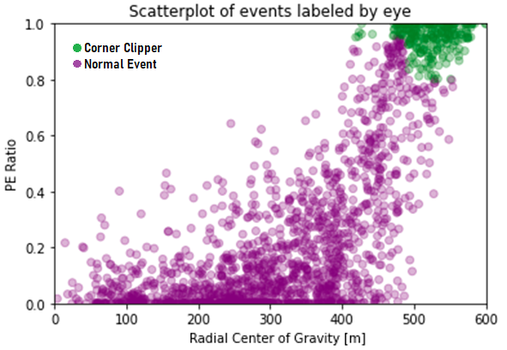
Classification methods
Tried multiple classification algorithms after labeling data (3,517 events, 737 clippers → 21% corner clippers)
K-Nearest Neighbors
Decision Trees
Random Forests
Made scatter plot to see locations
Green = corner clipper
Purple = normal

Slide 15
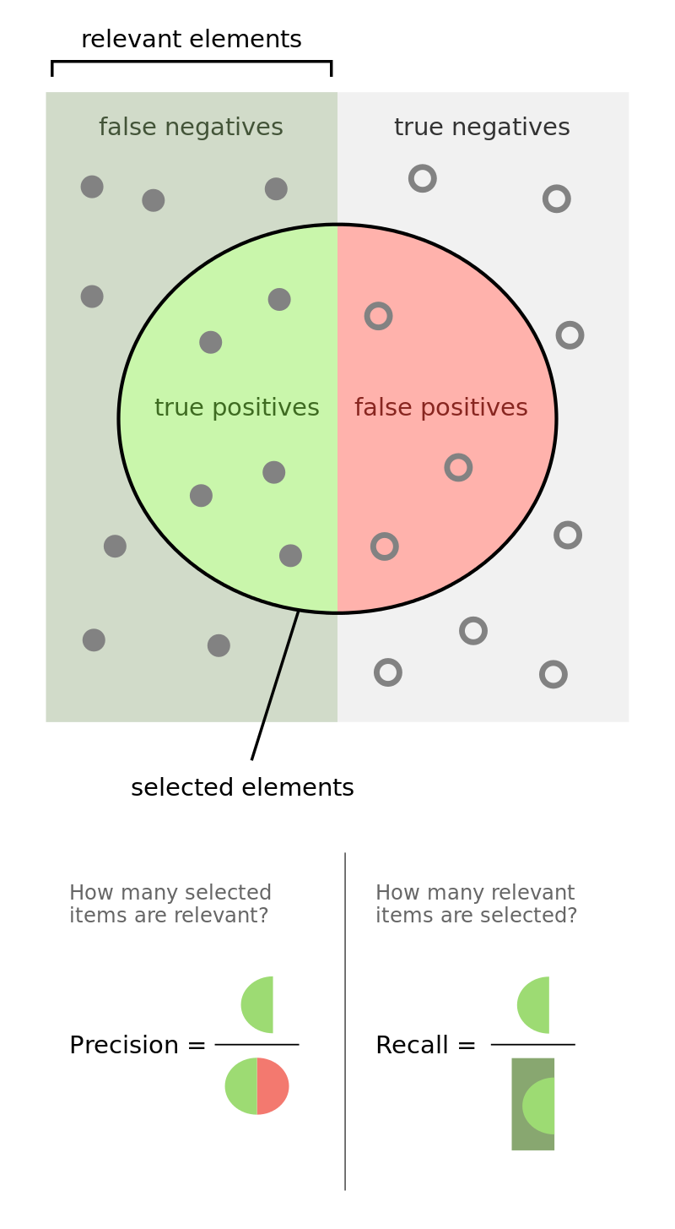

What makes an algorithm good?
 | Corner clipper (true label) | Normal event (true label)
Corner clipper (prediction) | True Positive | False positive
Normal event (prediction) | False Negative | True Negative
Look at Completeness (recall) and Precision
$$Completeness= \frac{\#True positives}{\#True positives+\#False Negatives}$$
$$Precision= \frac{\#True positives}{\#True positives+\#False Positives}$$
Prioritize completeness > precision (want low #FN)
Picture from https://en.wikipedia.org/wiki/F-score

Slide 16
Algorithm comparisons
Tried multiple algorithms
Found the best by comparing precision & completeness values
Random Forest performed best
 | Hard-Cut | K-Nearest Neighbors | Gaussian Naïve Bayes | Decision Tree | Decision Tree w/ Bagging | Random Forest | MPLRegression | Support Vector Machine
Precision | 0.99 | 0.8 | 0.72 | 0.97 | 0.94 | 0.99 | 0.94 | 0.9
Completeness | 0.67 | 0.47 | .06 | 0.93 | 0.87 | 0.96 | 0.86 | 0.8
Info about the different algorithms can be found at https://scikit-learn.org/stable/supervised_learning.html
and https://scikit-learn.org/stable/modules/generated/sklearn.neural_network.MLPRegressor.html

Slide 17
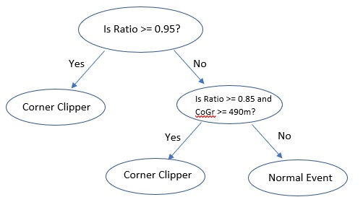
Random Forest
Based off Decision Trees
Creates multiple trees (makes a forest) w/
varying attributes and depth
Final tree is made by combining results
of all trees

Slide 18

Conclusions
Algorithm works very well (1,759 test events , only 14 mislabeled → 99.2% correct)

Slide 19
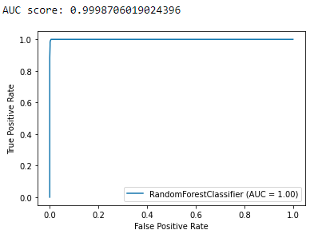

Conclusions 2
AUROC Curve
Closer the value is to 1, the better
Measures degree of separability^{[3]}
Very close to 1, another good sign
$$TPR=\frac{\#TP}{\#TP+\#FN}$$
$$FPR= \frac{\#FP}{\#TN+FP}$$

Slide 20
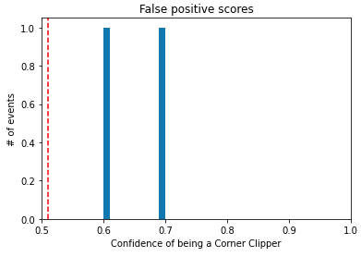
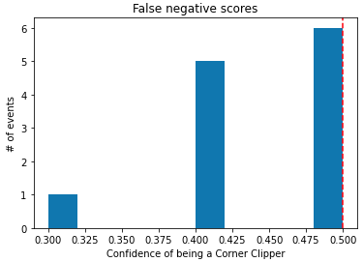
Incorrect events
 | Corner clipper (true label) | Normal event (true label)
Corner clipper (prediction) | True Positive | False positive
Normal event (prediction) | False Negative | True Negative
How incorrect are they?
What type of event is hard to classify?

Slide 21
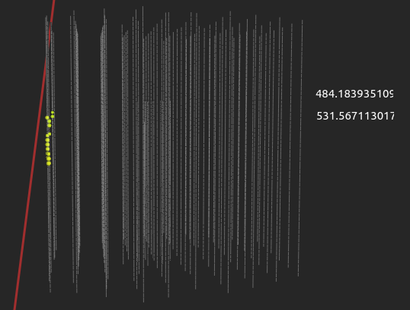
Example of a false negative
Event is a corner clipper, but not labeled
as one
2 different CoGr’s could be the issue
Built-in definition
My CoGr definition

Slide 22
Future improvements
Overall, the method to identify corner clippers works very well
Can still be improved (fix CoGr issue)
Replace Random Forest w/ faster algorithm
Test on more/different event topologies

Slide 23

Acknowledgements
A HUGE Thank You to Dr. Kurahashi and her grad students Mike C, Mike K, Luna, and Steve!
You guys are the best!!

Slide 24
Sources
[1] CARVER, Tessa. Time Integrated searches for Astrophysical Neutrino Sources using the IceCube Detector and Gender in Physics studies for the Genera Project. Université de Genève. Thèse, 2019. doi: 10.13097/archive-ouverte/unige:120924 https://archive-ouverte.unige.ch/unige:120924
[2] Wakefield, K. (n.d.). A guide to the types of machine learning algorithms. Retrieved March 09, 2021, from https://www.sas.com/en_gb/insights/articles/analytics/machine-learning-algorithms.html#:~:text=At%20its%20most%20basic%2C%20machine,values%20within%20an%20acceptable%20range.&text=There%20are%20four%20types%20of,%2Dsupervised%2C%20unsupervised%20and%20reinforcement.
[3] Narkhede, S. (2021, January 14). Understanding AUC - ROC Curve. Medium. https://towardsdatascience.com/understanding-auc-roc-curve-68b2303cc9c5.

Slide 25
Questions?

